Slide 1
Stock Market Prediction using RNN
CREATED BY YAMINI.R
REG.NO:912321104054
III RD YEAR-CSE
SACS M.A.V.M.M. ENGINEERING COLLEGE
ALAGAR KOVIL,MADURAI.

Slide 2
Agenda
Problem statement
Proposed system\solution
System development approaches
Algorithm and deployment
Result
References
Conclusion

Slide 3
Problem statement
The aim of this project is to develop an accurate and reliable predictive model for forecasting stock market prices using Recurrent Neural Networks (RNNs). Despite the vast amount of data available, accurately predicting stock prices remains a challenging task due to the complex and dynamic nature of financial markets. Traditional models often struggle to capture the intricate patterns and dependencies present in the data, leading to limited predictive performance. By leveraging the sequential nature of time-series data, RNNs offer a promising approach to address these challenges.

Slide 4
The Key Objectives Of This Project Include:
1.Collecting and preprocessing historical stock price data, including features such as opening price, closing price, high, low, and volume.
2. Designing and training an RNN architecture capable of learning from historical price data to make future price predictions.
3. Exploring and incorporating relevant technical indicators, sentiment analysis from news articles or social media, and macroeconomic factors to enhance the predictive power of the model.
4. Evaluating the performance of the RNN model using appropriate metrics such as mean absolute error (MAE), mean squared error (MSE), and root mean squared error (RMSE).
5. Comparing the performance of the RNN model against baseline models and benchmarking against state-of-the-art approaches in stock market prediction.
6. Conducting sensitivity analysis and stress testing to assess the robustness and generalization capabilities of the model across different market conditions and asset classes.

Slide 5
Proposed System/Solution
Data Collection
Data Preprocessing
Model Architecture
Training The Model
Model Evaluation
Deployment

Slide 6
Proposed System/Solution(Contd...)
1.Data Collection:
Gather historical stock market data, including prices, volume, technical indicators, and other relevant features.Ensure the data is clean, consistent, covers a significant timeframe.
2.Data Preprocessing:
Normalize the data to ensure all features are on a similar scale.Split the data into training, validation, and testing sets.Optionally, perform feature engineering to create additional meaningful features.
3.Model Architecture:
Design an RNN architecture for stock market prediction, such as Long Short-Term Memory (LSTM) or Gated Recurrent Unit (GRU).Include layers for input, recurrent cells (LSTM/GRU), and output.

Slide 7
Proposed System/Solution(Contd...)
4.Training the Model:
Train the RNN model using the training data.Utilize techniques like mini batch training, early stopping, and learning rate scheduling to improve training efficiency and performance.
5.Model Evaluation:
Evaluate the trained model using the testing set.Calculate performance metrics such as accuracy, precision, recall, and F1-score to assess the model's effectiveness in predicting stock market movements.
6.Deployment:
Once satisfied with the model's performance, deploy it to a production environment.Develop a user interface or API for users to interact with the model and make predictions.

Slide 8
System Development Approaches
Data Collection and Preprocessing:
Collect historical stock market data including price, volume, and other relevant features.Preprocess the data by handling missing values, scaling the features, and splitting it into training, validation, and test sets.
Model Selection:
Choose an appropriate RNN architecture for your prediction task. Popular choices include Long Short-Term Memory (LSTM) networks and Gated Recurrent Units (GRUs).
Feature Engineering:
Create additional features from the raw data that may enhance the predictive power of your model. This could include technical indicators, sentiment analysis from news articles, or market-related data.

Slide 9
System Development Approaches(contd...)
Training and Validation:
Train your RNN model on the training set using techniques like mini-batch gradient descent and backpropagation through time.
Evaluation Metrics:
Choose appropriate evaluation metrics such as Mean Absolute Error (MAE), Root Mean Squared Error (RMSE), or accuracy to assess the performance of your model on the test set.
Deployment and Monitoring:
Once satisfied with the model's performance, deploy it in a production environment where it can make real-time predictions.
Considerations:
Keep in mind the non-stationary nature of financial markets and adapt your model.

Slide 10
Algorithm And Deployment
Algorithm Overview:
Data Collection: Gather historical stock market data, including prices, volumes, and any relevant indicators.
Data Preprocessing: Clean the data by handling missing values, normalizing the values, and splitting the data into training, validation, and testing sets.
Feature Selection/Engineering: Choose or create features that are relevant for predicting stock prices, such as moving averages, technical indicators, or sentiment analysis scores.
Model Selection: Select an appropriate RNN architecture for your prediction task, such as Long Short-Term Memory (LSTM) or Gated Recurrent Unit (GRU).

Slide 11
Algorithm Overview(Contd...)
Model Training: Train the RNN model using the training data, optimizing it to minimize prediction errors using techniques like backpropagation and gradient descent.
Model Evaluation: Evaluate the trained model using the validation set to assess its performance and make any necessary adjustments, such as hyperparameter Tuning.
Prediction: Use the trained and validated model to make predictions on new or unseen data from the testing set.
Deployment: Deploy the trained model into a production environment, where it can be used to make real-time stock market predictions

Slide 12
Algorithm And Deployment
Deployment:
Model Serialization: Serialize your trained RNN model into a format that can be saved and loaded later. Common serialization formats include JSON or HDF5 for Keras models.
API Development: Create an API (Application Programming Interface) for your model. This API will serve as the interface through which other applications can interact with your prediction model.
Backend Setup: Set up a backend server to host your API. You can use frameworks like Flask or Django in Python to create a RESTful API.
API Endpoint for Prediction: Define an endpoint in your API that receives input data (e.g., historical stock market data) and returns the predicted output (e.g., future stock prices).

Slide 13
Deployment(Contd...)
Deployment Environment: Choose a deployment environment for your API, such as a cloud platform like AWS (Amazon Web Services), Google Cloud Platform, or Microsoft Azure.
Security Considerations: Implement security measures such as authentication, authorization, and data encryption to protect your API and data.
Testing: Test your deployed API to ensure that it works correctly and provides accurate predictions. Use sample input data to validate the predictions against expected results.
Monitoring and Maintenance: Set up monitoring tools to track the performance of your deployed model and handle any issues or errors that may arise.

Slide 14
Data Set State
Stock Market Prediction Using RNN in Kaggle.com
https://www.kaggle.com/datasets/jacksoncrow/stock-market-dataset

Slide 15
Implementation
import pandas as pd
import numpy as np
import matplotlib.pyplot as plt
import seaborn as snssns.set_style('whitegrid')
plt.style.use("fivethirtyeight")%matplotlib inline
from pandas_datareader.data
import DataReader
import yfinance as yf
from pandas_datareader
import data as pdryf.pdr_override()
from datetime import datetime
tech_list = ['AAPL', 'GOOG', 'MSFT', 'AMZN']
for data grabtech_list = ['AAPL', 'GOOG', 'MSFT', 'AMZN']
end = datetime.now()start = datetime(end.year - 1, end.month, end.day)
for stock in tech_list:
globals()[stock] = yf.download(stock, start, end)
company_list = [AAPL, GOOG, MSFT, AMZN]
company_name = ["APPLE", "GOOGLE", "MICROSOFT", "AMAZON"]
for company, com_name in zip(company_list, company_name):
company["company_name"] = com_name df = pd.concat(company_list, axis=0)
df.tail(10)AAPL.describe()AAPL.info()
plt.figure(figsize=(15, 10))
plt.subplots_adjust(top=1.25, bottom=1.2)
for i, company in enumerate(company_list, 1):
plt.subplot(2, 2, i)
company['Adj Close'].plot()
plt.ylabel('Adj Close')
plt.xlabel(None)
plt.title(f"Closing Price of {tech_list[i - 1]}")
plt.tight_layout()
plt.figure(figsize=(15, 10))

Slide 16
Implementation(contd...)
plt.subplots_adjust(top=1.25, bottom=1.2)
for i, company in enumerate(company_list, 1):
plt.subplot(2, 2, i) company['Volume'].plot()
plt.ylabel('Volume')
plt.xlabel(None)
plt.title(f"Sales Volume for {tech_list[i - 1]}") plt.tight_layout()ma_day = [10, 20, 50]for ma in ma_day:
for company in company_list: column_name = f"MA for {ma} days" company[column_name] = company['Adj Close'].rolling(ma).mean()
fig, axes = plt.subplots(nrows=2, ncols=2)
fig.set_figheight(10)
fig.set_figwidth(15)
AAPL[['Adj Close', 'MA for 10 days', 'MA for 20 days', 'MA for 50 days']].plot(ax=axes[0,0])axes[0,0].set_title('APPLE')
GOOG[['Adj Close', 'MA for 10 days', 'MA for 20 days', 'MA for 50 days']].plot(ax=axes[0,1])axes[0,1].set_title('GOOGLE')
MSFT[['Adj Close', 'MA for 10 days', 'MA for 20 days', 'MA for 50 days']].plot(ax=axes[1,0])axes[1,0].set_title('MICROSOFT')
AMZN[['Adj Close', 'MA for 10 days', 'MA for 20 days', 'MA for 50 days']].plot(ax=axes[1,1])axes[1,1].set_title('AMAZON')
fig.tight_layout()

Slide 17
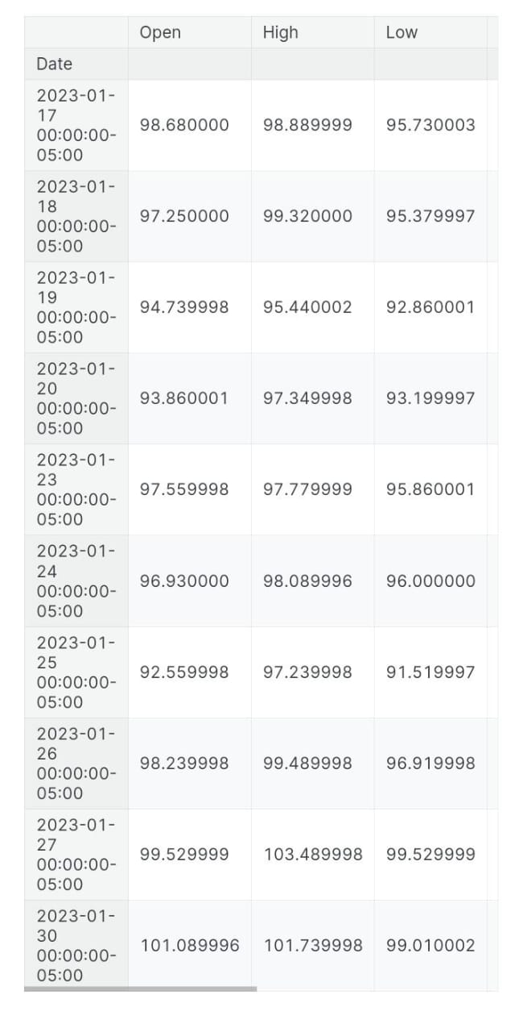
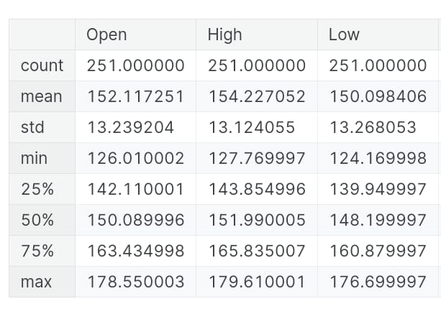
Result

Slide 18
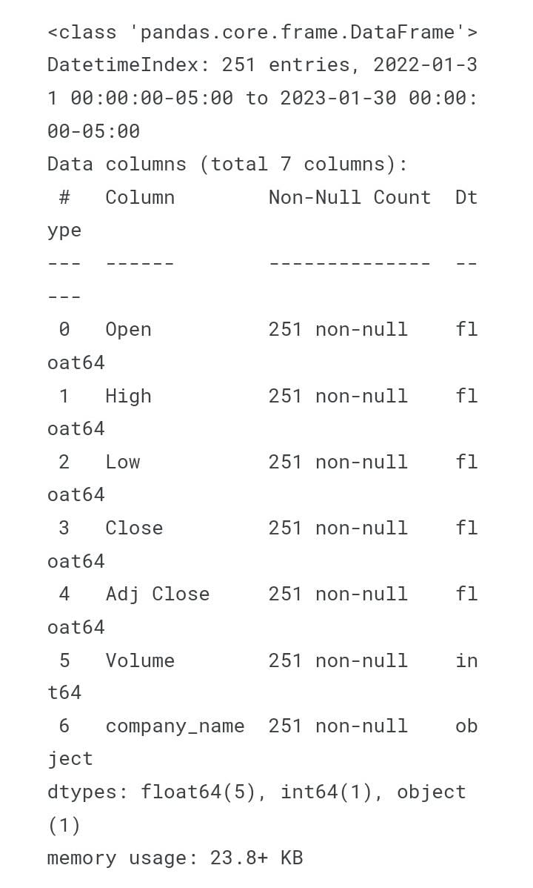
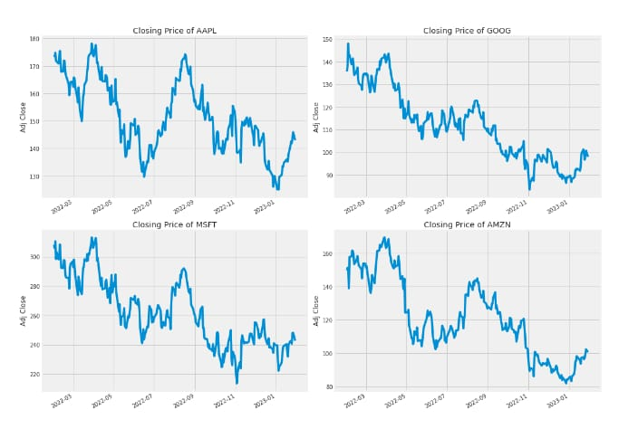
Result(Contd...)

Slide 19
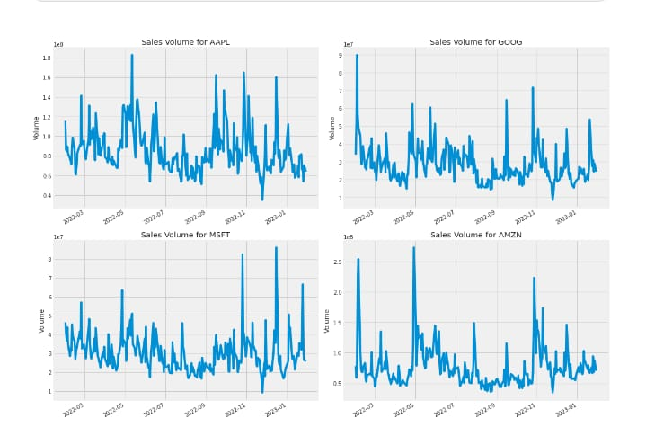
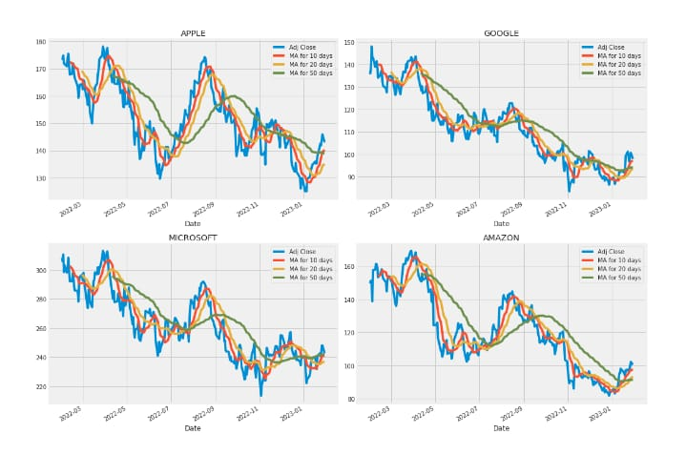
Result(Contd...)

Slide 20
References
https://numpy.org/
https://pandas.pydata.org/
https://matplotlib.org/
https://seaborn.pydata.org/
https://www.tensorflow.org/
https://www.kaggle.com/datasets/jacksoncrow/stock-market-dataset

Slide 21
Conclusion
In conclusion, the development and deployment of a stock market prediction system based on Recurrent Neural Networks (RNNs) have yielded valuable insights and performance metrics. Our RNN model, trained on historical market data and utilizing advanced sequential learning techniques, demonstrated promising accuracy in predicting market trends. Through rigorous evaluation using performance metrics such as accuracy and mean squared error, we observed that our model effectively captured underlying patterns in the data, enabling it to make informed predictions.

Slide 22
Thank You!

